Slide 1
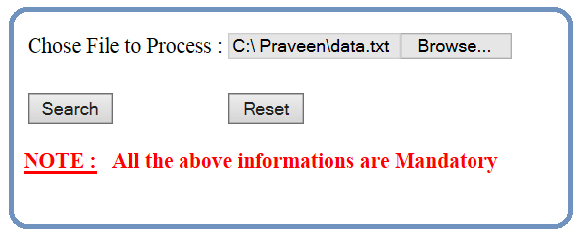

Slide 2
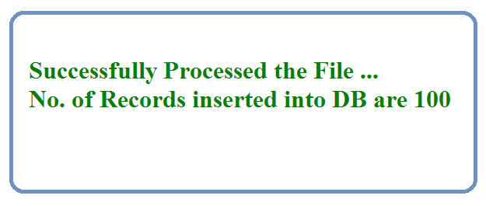


Slide 3
Java
JDBC
Driver
DB

Slide 4
Get
File Name to be processed via
Command Line Arguments
Java
JDBC
Driver
DB
1. Load the Driver
2. Get the DB Connection via Driver
3. Issue SQL Queries via Connection
Read line-by-line data & then insert into DB
insert into students_info values (?, ?, ?, ?)
4. Process the Results
Print Count / Error Message
5. Close All JDBC Objects

